Slide 1
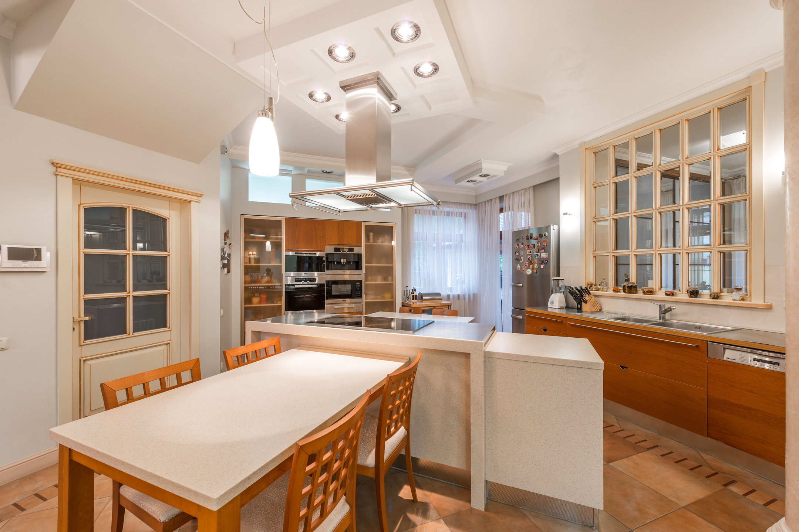
WHAT WOULD
YOU MOVE?
Find three places to clear
before listing photos.
Notes:
What would you move? A real kitchen with small appliances on the counter, magnets on the fridge and jars along the windowsill. Find three places to clear before listing photos.

Slide 2
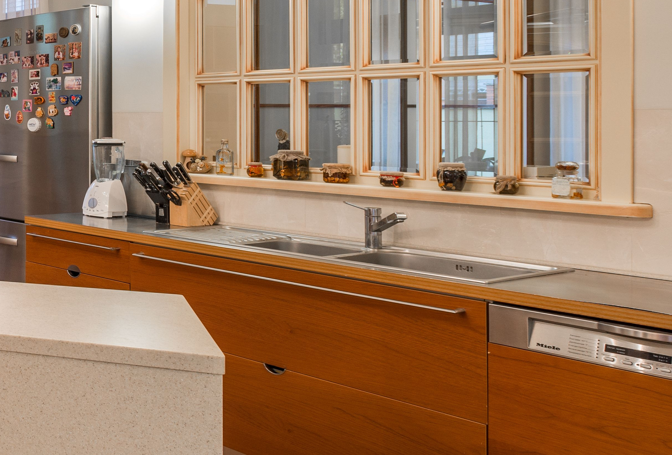
CLEAR THE
COUNTER.
Pack the blender and knife block.
Wipe the worktop and tuck away
any trailing cords.
Notes:
Clear the counter. A close crop of the same kitchen shows a blender and knife block beside the sink. Pack these, wipe the worktop and tuck away any trailing cords.

Slide 3
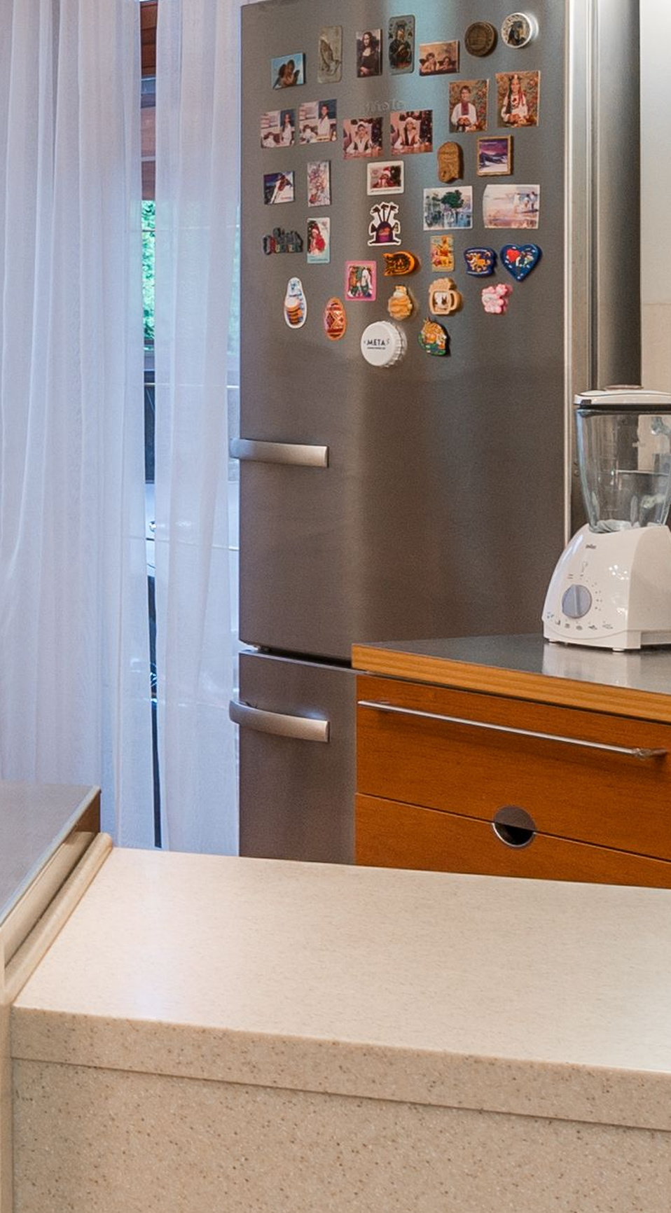
UNPIN THE
FRIDGE.
Take down
magnets, photos
and notes.
Then wipe away
fingerprints.
Notes:
Unpin the fridge. A tall close crop reveals the fridge covered with souvenir magnets. Take down magnets, photos and notes, then wipe away fingerprints.

Slide 4
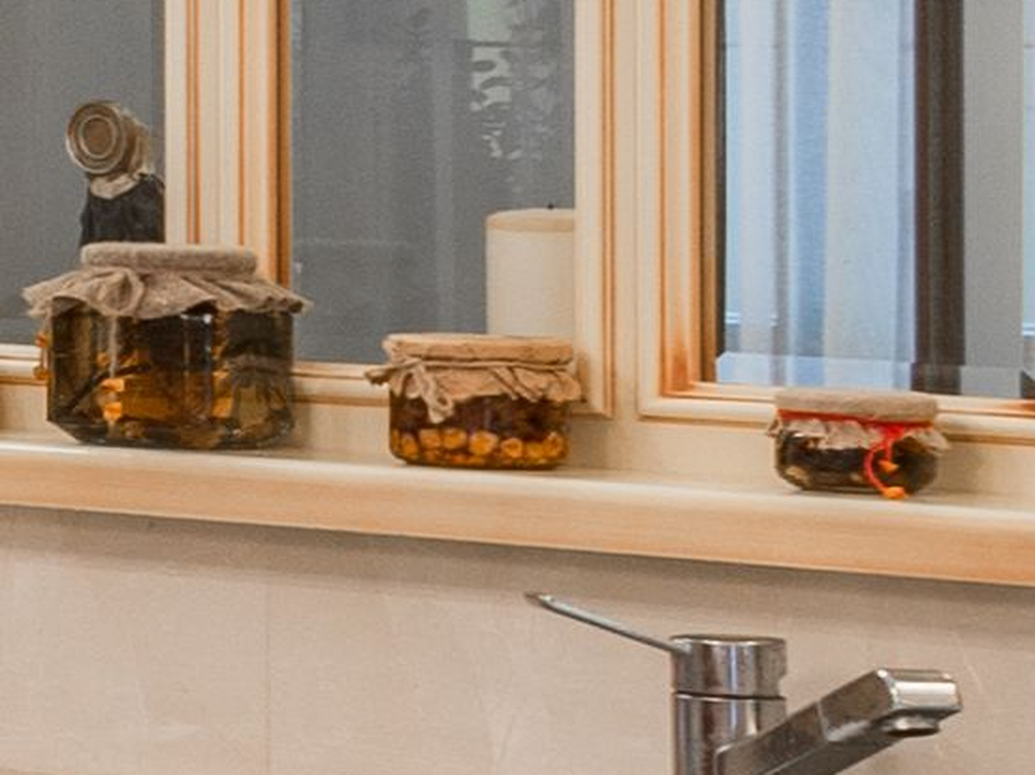
CHECK THE
EDGES.
The windowsill is easy to miss.
Clear the little jars and bottles, too.
Notes:
Check the edges. An enlarged crop of the kitchen windowsill reveals a long row of small jars and bottles. The windowsill is easy to miss. Clear the little jars and bottles, too.

Slide 5
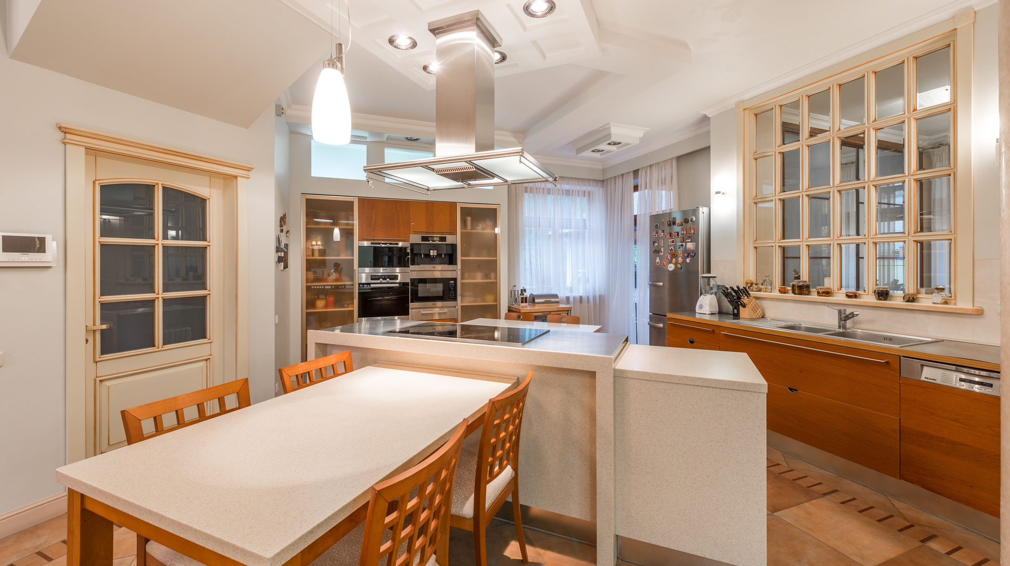
TRY THE
DOORWAY TEST.
Take a quick phone photo from the doorway.
Zoom in and scan every edge.
Put the extras in a box before
the photographer arrives.
Save this for photo day.
Notes:
Try the doorway test. The full kitchen returns. Take a quick phone photo from the doorway, zoom in and scan every edge, then put the extras in a box before the photographer arrives. Save this for photo day.

